Slide 1

Hiring Process Analytics for a Multinational Company
Naveen Ramesh
BADM-WD-T-B5

Slide 2

About Project
This project analyze the hiring process data of a multinational company to identify patterns, trends, and insights that can help optimize the hiring process, improve decision-making, and enhance overall recruitment efficiency using MS Excel.

Slide 3
Hiring Analysis:
To determine the gender distribution of hires:
For the Pie chart, we can infer that more than half of the hired candidates are male(55%) and only 39% of them are female, the rest haven’t disclosed there gender.
The organization should therefore focus on decreasing the gender ratio.

Slide 4
Salary Analysis
To find the average salary offered by this company:
The Bar chart infers that the Average Offered Salary Is 49983 And The Average Salary Of Hired Candidates Is 49753.
Hence, the Average Salary Of Hired Candidates Is Almost Same As That Of Offered Salary. This Shows That The Hiring Team Is Recruiting Candidates As Per The Pre-determined Salary Bands Of The Organization.

Slide 5
Salary Distribution
To create class intervals for the salaries in the company:
This chart infers that the salary range 40000-59999 given to the candidates(1532) which is the highest in count, with hired-1022 and rejected-510. The least salary range is 80000-99999 with 1370 candidates with hired(873) and rejected(497).
2, 3 and 4lakh range also given which can be considered as outliers.
We can observe that the most candidates hired for middle experience posts and least for senior most posts and for fresher's.

Slide 6
Departmental Analysis
To show the proportion of people working in different departments:
From the bar chart, we can observe that most candidates are hired in operations department followed by services department and sales department and the least candidates are hired in human resource department.
These numbers may indicate the size of teams and importance of the departments in the organization.

Slide 7
Position Tier Analysis
To represent the different position tiers within the company:
Here, from this chart, we can observe that the organization has hired most candidates for post tier c9 followed by c5 and then i7 at distant third. This helps to understand the distribution of positions across different tiers.

Slide 8
Interview Time Analysis
To identify any trends related to the date or time of the interviews and to know the specific periods when hiring rates are higher or lower:
From the chart we can infer that, in the month of July most of the interview happened with the candidates count of 1946 – Hired(1296) & Rejected(650) followed by August.
The least number of interviews took place in the month of June with 1640 candidates – Hired(1079) & Rejected(561) followed by May.
Hence, we can observe that the Organization does most number of interviews on July based on the requirement, as the hired rates are increasing.

Slide 9
Interview Metrics Analysis
To find the metrics such as the average number of interviews conducted per department and the other related measures:
From the bar chart, we can observe that most interviews done by Operations Department(Average Salary offered: 49151) followed by Services Department department(Average Salary offered: 49151), Sales Department (Average Salary offered: 49151) and the least candidates are hired in Human Resource Department (Average Salary offered: 49151). General Management role offers the highest average salary of 58722.
Hence, we can observe that the candidates applies job mostly in Operations, Services and Sales department irrespective(no relation) of the salary also the demand is high with regards to the Organization as well.

Slide 10
Departmental Hiring Trends
To compare department-wise hiring trends by analyzing the number of hires, rejections, and time-to-hire(months) across different departments.
From the chart we can infer that the Operations Department have done the highest hires with 1843 candidates(Hired most of the candidates on July month)followed by Service(Hired most of the candidates on August month) and Sales Department(Hired most of the candidates on August month). The Human Resource Department have done the least hires with 70 candidates.
Hence, we can observe that, the departments hire their candidates mostly on the month of July & August, which can due to the vacancy and demand. The Organization can increase the hiring ratio in other departments to increase the productivity better.

Slide 11
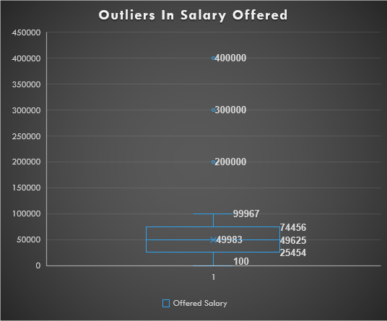
Outliers In Salary Offered
This box plot shows the percentile and outliers available in the offered salary field, below;
25th percentile: 25454
50th percentile:49625
75th percentile:74456
Outliers: 200000, 300000, 400000

Slide 12
Dataset Overview
The dataset contains records of candidates who were interviewed previously with information about hiring status, hiring department, salary etc.
The dataset details are: - number of data-points: 7,168 - number of features: 7 - column details: 1. Application_id: ID of the applicant 2. Interview taken on: date and time of the interview 3. Status: hired or rejected 4. Event_name: gender of the applicant 5. Department: name of the department for which interview was conducted 6. Post name: name of the post offered 7. Offered salary: salary offered for the job
Attached below the analysed Data set(with Dashboard)

Slide 13
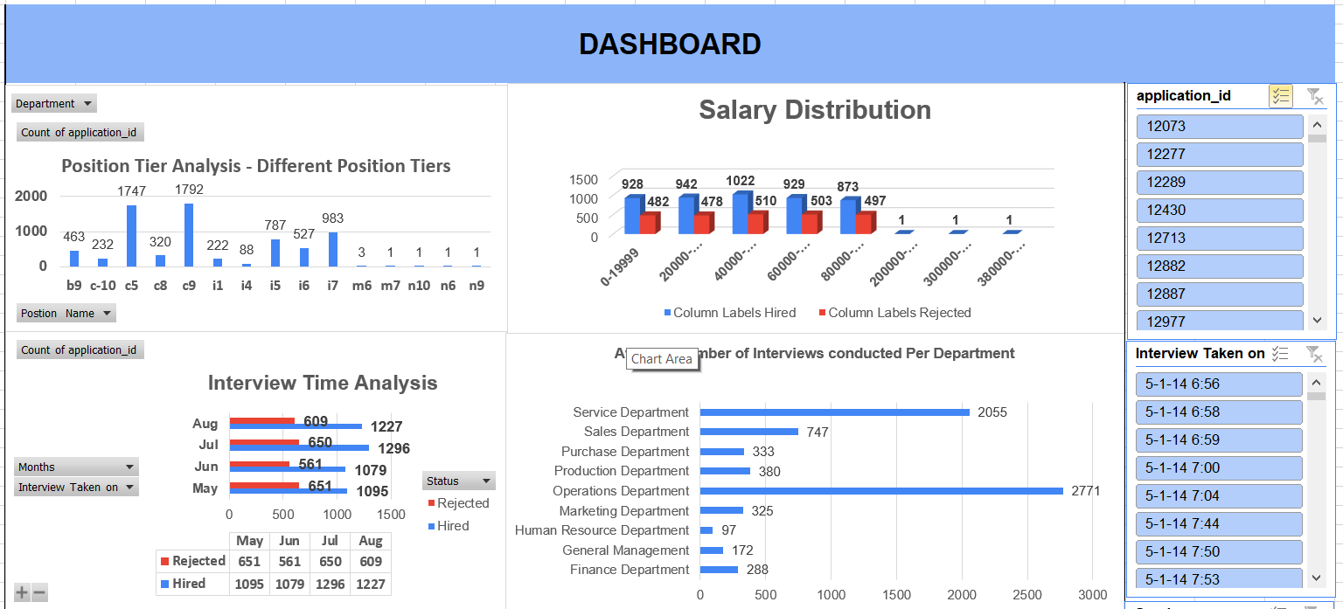
Sample Dashboard

Slide 14

Conclusion
This project helped me to understand, how important data analytics is for hiring process of an organization as it provides valuable insights such as number of hires & rejections, profile of applicants, vacancies, Interview time & metrics, Department & Position wise analysis and Gender wise analysis, which greatly helps the hiring department to take data-driven decisions.

Slide 15
Thank You!

